Slide 1
Dengue Disease Prediction & Analysis
Powered by Machine Learning

Slide 2
Members Team Alpha II
RA1611008010189 Vaibhav Dadhich
RA1611008010285 Mohnish Khera
RA1611008010441 Manu Anand
RA1611008010677 Pranav Jha
Guided by Ms. Geetha

Slide 3

INTRODUCTION
Dengue fever is an irresistible illness likewise called as a break borne fever or dandy fever or dengue haemorrhagic fever caused by a group of virus which are transmitted by mosquitoes.
The family of mosquitoes which transmits dengue virus will also leads into diseases like chikungunya, yellow fever and zika virus.
Zika and dengue infections are classified as biological safety level (BSL) 2 pathogens while chikungunya virus is classified as a BSL-3 agent.
The symptoms of Zika are comparable to those of dengue and chikungunya, which are infections caused by other viruses spread by the same sort of mosquitoes.
The virus is ordered into four serotypes alluded to as DV-1, DV-2, DV-3 and DV-4, where DV is a positive-stranded epitomized RNA infection.
Alternate mosquitoes get contaminated due to the admission of the blood from a man who is tainted with dengue infection.
OBJECTIVE
Implement various machine learning algorithms: Support Vector Machine (SVM), Decision Tree (DT), Tree Bagger (TB) and perform Data Analysis to predict the accuracy and precision of the diagnosis.

Slide 4

EXISTING SYSTEM
Existing process is supported by Naïve Baye’s algorithm to ﬁnd the optimal loci classiﬁcation subset. Followed by an Artiﬁcial Neural Network (ANN) which is used to classify patients under dengue.
The approach for the prediction of dengue fever severity solely on human genome data: A dual approach based on SVM for SNP selection and artiﬁcial neural networks (ANN) for prediction.
ISSUES
Doesn’t develop genomic signatures.
Doesn’t involve polymorphisms present in both innate and anti-viral responses genes.
Uses one-by-one SNP gene testing.
Doesn’t multivariate genome signatures.
Develops only single individual markers.

Slide 5
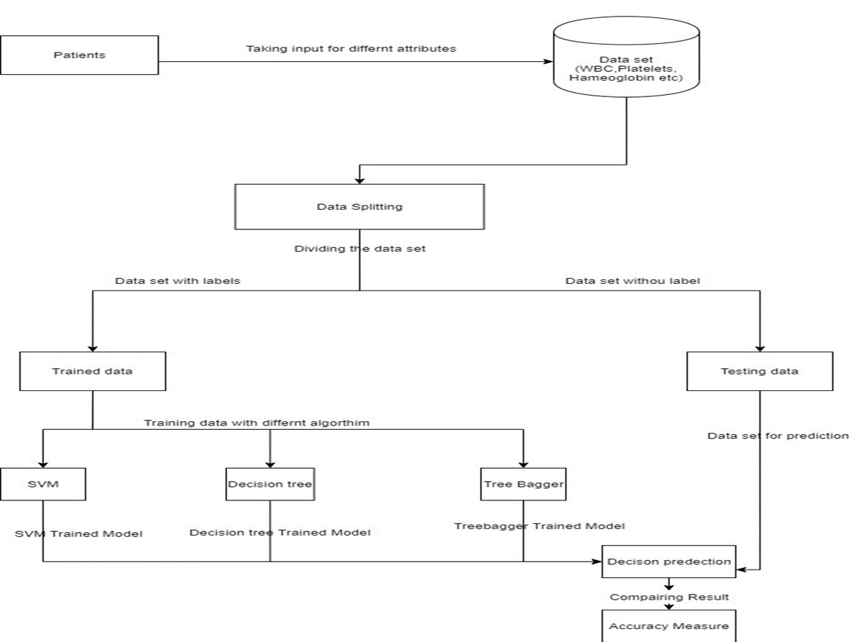
Proposed System Architecture

Slide 6
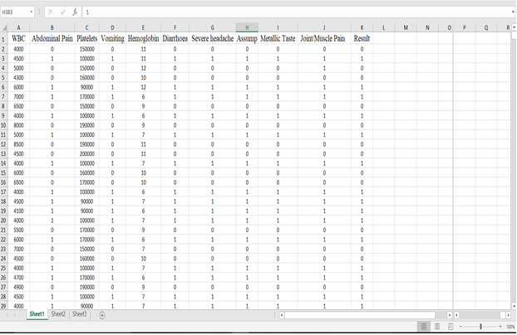
Proposed System Workflow
1. Dataset Preparation
The dengue disease data set is obtained from CHENNAI Hospitals. We use 10 medical data attributes i.e. WBC, Hemoglobin, Platelets, Abdominal Pain, Vomiting, Diarrhea, Severe headache, Dengue, Metallic Taste, Joint/Muscle Pain for dengue disease prediction.
Understanding the data set

Slide 7
Proposed System Workflow
2. Information Preprocessing
The dataset contains unique characteristics and NaN esteems. In programming, we can't process the NaN esteems so these qualities are changed into another worth for example numerical worth. NaN esteems are supplanted by the mean estimation of segments.
______________________________________________________
3. Information Splitting
The parting step is utilized for making the preparation and testing information to the examining procedure.
Our entire dataset is isolate into preparing and testing information; utilize 80% of information for preparing and 20% of information for testing.
Out of a total of 500, the training dataset consists of 396, while the testing dataset consists of 104.

Slide 8
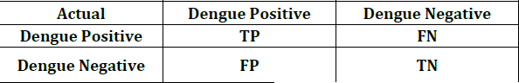
Proposed System Workflow
4. Classification
In classification, split training and testing data are valuated based on machine learning models.
First, training data was trained by using three different machine learning models such as Support Vector Machine, Decision Tree and Tree-Bagger.
After that testing information are approved dependent on prepared information with a high arrangement precision rate.
To compute Accuracy, precision, and recall, the confusion matrix is needed:
Confusion Matrix

Slide 9

MODULESPLIT
1. Support Vector Machine (SVM)
A Support Vector Machine is a supervised learning algorithm. An SVM models the data into k categories, performing classification and forming an N-dimensional hyper plane. These models are very similar to neural networks.
Support Vector Machine

Slide 10
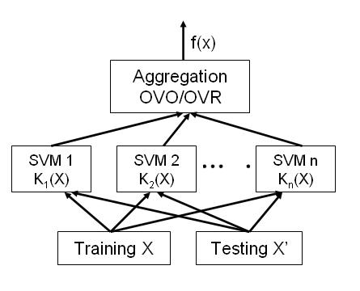
MODULESPLIT
Consider a dataset of N dimensions. The SVM plots the training data into an N dimensioned space.
The training data points are then divided into k different regions depending on their labels by hyper-planes of n different dimensions.
After the testing phase is complete, the test points are plotted in the same N dimensioned plane.
Depending on which region the points are located in, they are appropriately classified in that region.
Support Vector Machine

Slide 11
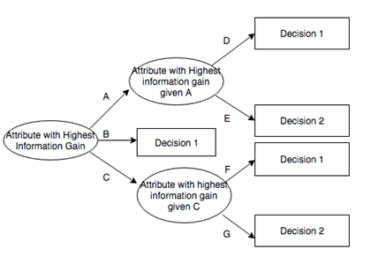
MODULESPLIT
2. Decision Tree (DT)
Decision tree is a type of supervised learning algorithm that is mostly used in classification problems. It works for both categorical and continuous input and output variables.
Decision Tree

Slide 12
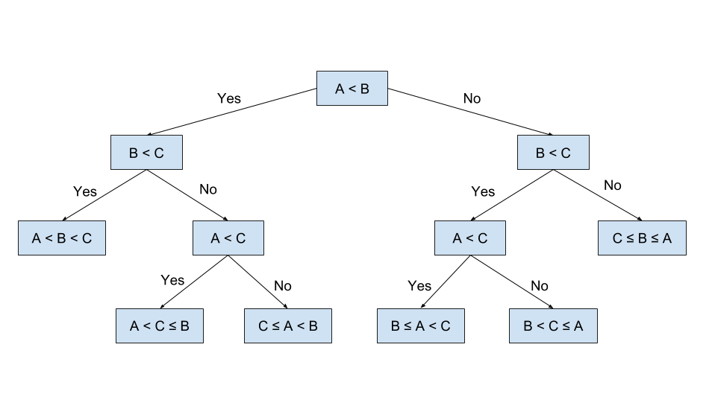
MODULESPLIT
In this technique, we split sample into two or more homogeneous sets (or sub-populations) based on most significant splitter / differentiator in input variables.
In decision tree internal node represents a test on the attribute, branch depicts the outcome and leaf represents decision made after computing attribute.
Decision Tree

Slide 13
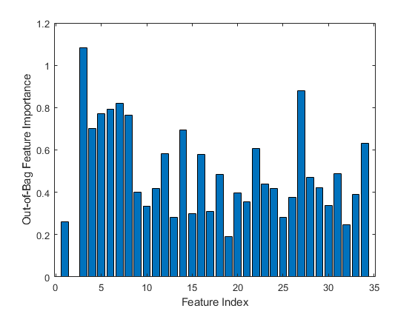
MODULESPLIT
3. Tree Bagger (TB)
Tree Bagger bags an ensemble of decision trees for either classification or regression.
Bagging stands for bootstrap aggregation.
Every tree in the ensemble is grown on an independently drawn bootstrap replica of input data.
Observations not included in this replica are "out of bag" for this tree.
Tree Bagger

Slide 14
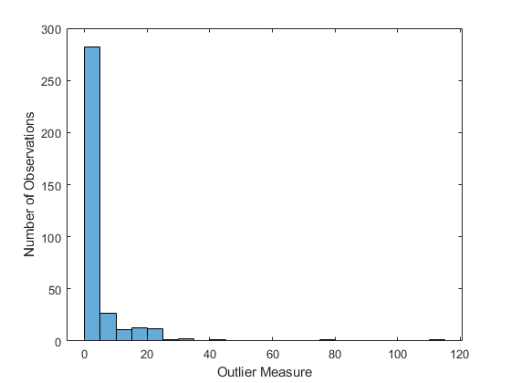
MODULESPLIT
Tree Bagger relies on the Classification Tree and Regression Tree functionality for growing individual trees.
In particular, Classification Tree and Regression Tree accepts the number of features selected at random for each decision split as an optional input argument.
Tree Bagger

Slide 15
Implementation Procedure
1. Obtain and gather raw data.
2. Pre-process these raw data sets.
3. Perform data visualization and data analysis.
4. Choose the various algorithm to be implemented.
5. Perform feature selection to enhance the accuracy.
6. Execute algorithms and obtain accurate, precise verification.
7. Final analysis and documentation.

Slide 16
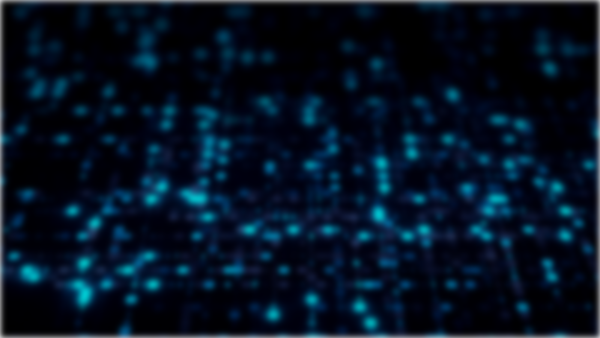
TOOLUSED
MATLAB
MATLAB is an unrivaled language for specialized enrolling. It facilitates computation, portrayal, and programming in an easy to-use condition where issues and plans are conveyed in common numerical documentation. Regular uses incorporate:
Math and calculation
Algorithm improvement
Data securing
Modeling, reproduction, and prototyping
Data investigation, investigation, and representation
Scientific and building illustrations
Application improvement, including graphical UI building

Slide 17
TOOLUSED
MATLAB is an interactive system whose basic data element is an array that does not require dimensioning.
This allows you to solve many technical computing problems, especially those with matrix and vector formulations, in a fraction of the time it would take to write a program in a scalar non interactive language such as C or Fortran.
The name MATLAB stands for matrix laboratory. MATLAB was originally written to provide easy access to matrix software developed by the LINPACK and EISPACK projects.
Today, MATLAB engines incorporate the LAPACK and BLAS libraries, embedding the state of the art in software for matrix computation.
MATLAB MATHEMATICAL FUNCTION LIBRARY
This is a vast collection of computational algorithms ranging from elementary functions, like sum, sine, cosine, and complex arithmetic, to more sophisticated functions like matrix inverse, matrix eigenvalues, Bessel functions, and fast Fourier transforms.

Slide 18
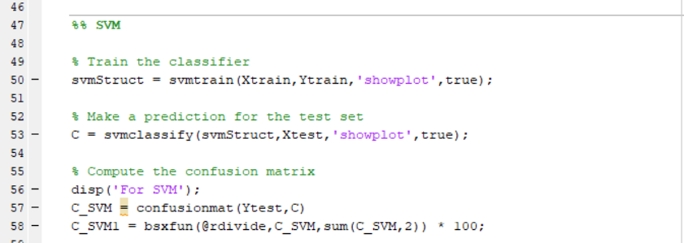
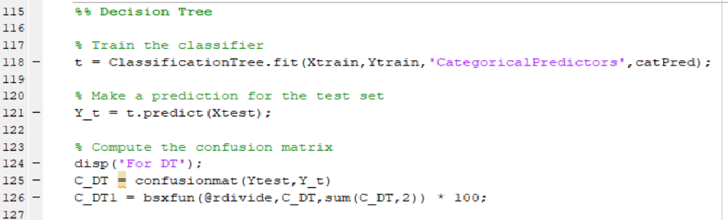
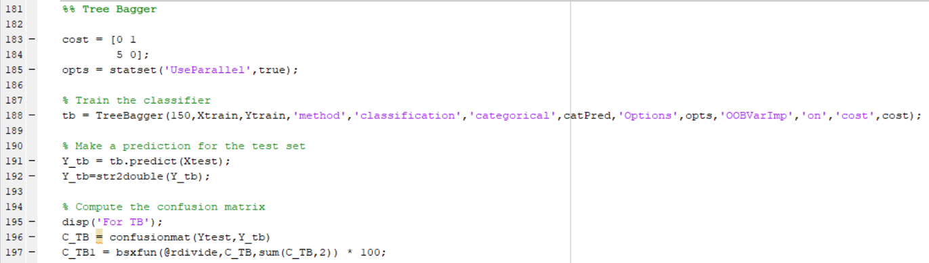
CODESNIPPETS
S
V
M
D
T
T
B

Slide 19
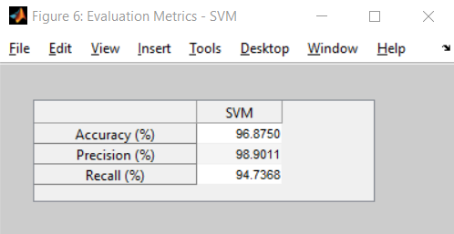
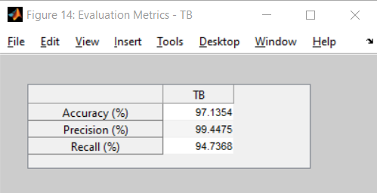
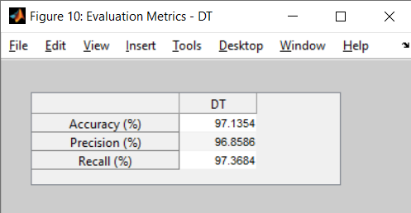
OUTPUTS
Support Vector Machine
Tree Bagger
Decision Tree
Evaluation Matrices

Slide 20
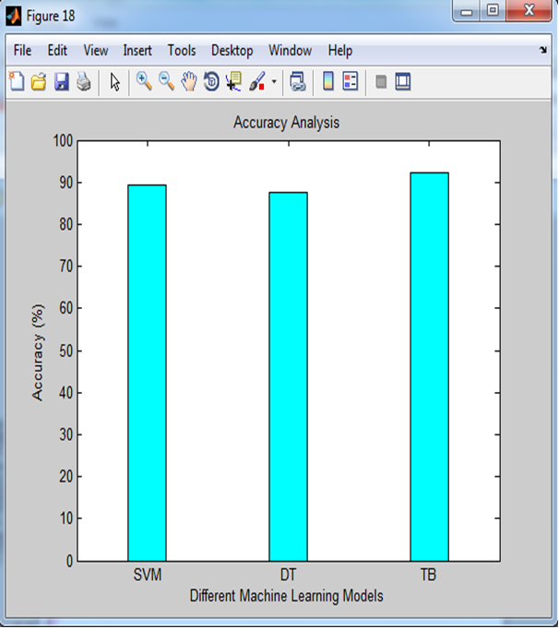
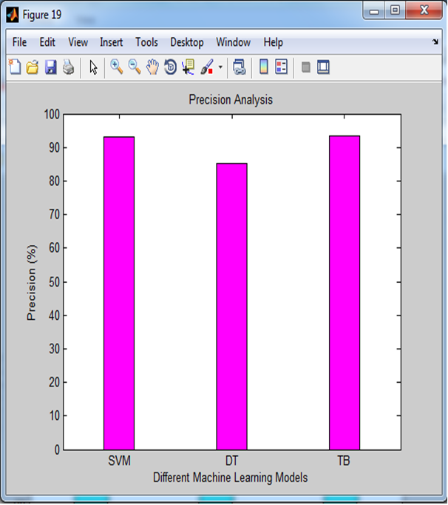
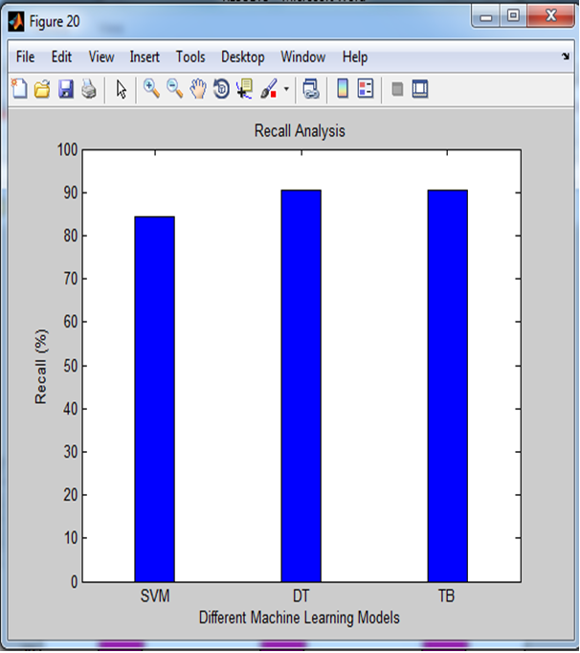
RESULTS
Accuracy
Precision
Recall
Graphical Analysis

Slide 21
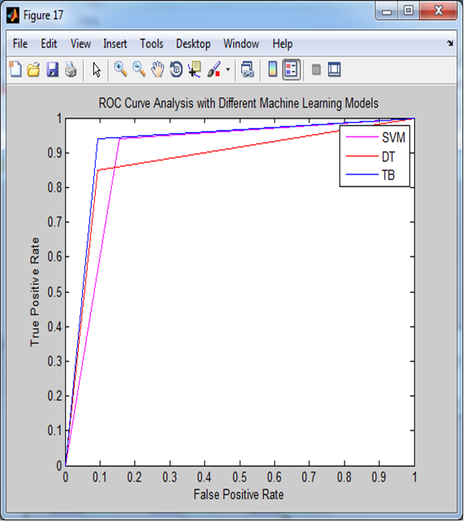
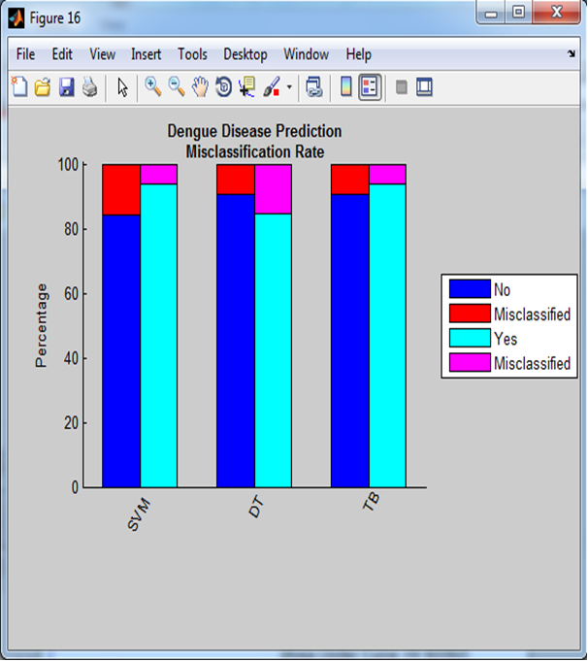
RESULTS
ROC Curve
Misclassification Curve
Comparison Curves

Slide 22
Conclusion
Tree bagger is the calculation which is the most impressive and gives the best yield as far as exactness, accuracy and review.
Bagging is the sort of system which is utilized when the objective is to lessen the change of the Decision tree.
Our goal here is that to frame a few subsets of information from preparing test picked haphazardly with substitution and afterward every assortment of the subset information is utilized to prepare their decision tree.
After comparing all these we observed that Tree Bagger is by far giving us the best prediction in terms of accuracy, precision and recall, and hence it is the best algorithm among all the three algorithms.

Slide 23
References
[1] Bhatt et al., “The global distribution and burden of dengue,” Nature vol. 496, no. 7446, p. 504, 2013.
[2] Ta-Chien Chan, Tsuey-Hwa Hu, Jing-Shiang Hwang, "Daily forecast of dengue fever incidents for urban villages in a city", International Journal of Health Geographics,2015.
[3] Tuan et al., “Sensitivity and specificity of a novel classifier for the early diagnosis of dengue,” PLoS neglected tropical diseases, vol. 9, no. 4, p. e0003638, 2015.
[4] Nandini V, Sriranjitha R, Yazhini TP, "Dengue detection and prediction system using data mining with frequency analysis", Computer Science & Information Technology (CS & IT), 2016.

Slide 24
References
[5] Chatterjee et al., “Clinical application of modified bag-of-features coupled with hybrid neural-based classifier in dengue fever classification using gene expression data,” Medical & biological engineering & computing, pp. 1–12, 2017.
[6] Dave Kaveri Atulbhai and Shilpa Serasiya, “A Survey: Prediction & Detection of Dengue – Mining Methods & Techniques, IJARIIE–ISSN (O)-2395-4396, Vol-3, Issue-2, 2O17.
[7] Early Detection of Dengue Using Machine Learning Algorithms 1N.Rajathi, 2S.Kanagaraj, 3R.Brahmanambika and 4K.Manjubarkavi, 1,2,3,4Kumaraguru College of Technology, Coimbatore-49. [8] Dengue fever prediction using classification techniques, R. Sanjudevi1, D. Savitha2

Slide 25
References
[9] Dengue Possibility Forecasting Model using Machine Learning Algorithms P.Muhilthini*1, B.S. Meenakshi*2, S.L. Lekha*3, S.T. Santhanalakshmi*4.
[10] Dengue Disease Prediction Using Decision Tree and Support Vector Machine, Dr.Arun Kumar.P.M, Chitra Devi.B, Kar-thick.P, Ganesan.M and Madhan.A.S

